Slide 1
Digital Electronics Crash course – day 1 Lab
21-AUG-2018
Abhimanyu Arora
Koh Yi Min Jason

Slide 2
555 Timer

Slide 3
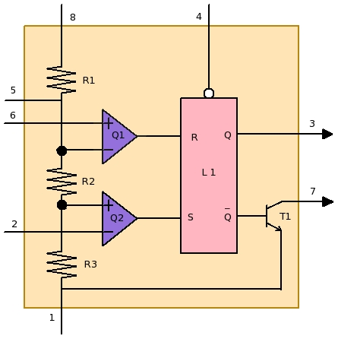
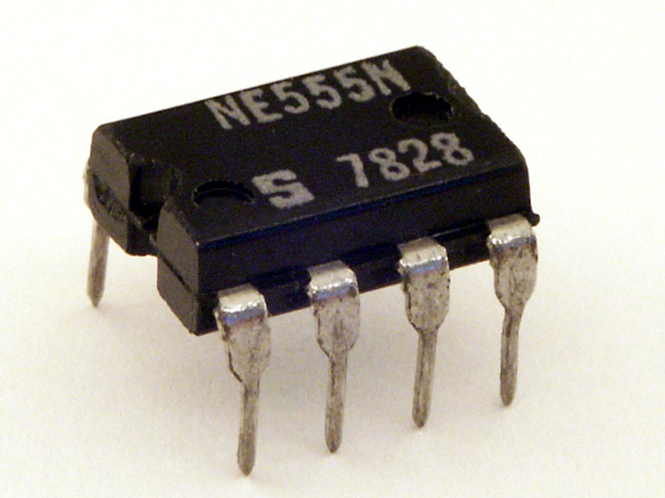
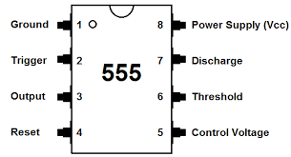
555 Timer
555 Timer The 555 timer is an 8 pin IC chip that can be use for wave generating, and circuit timing.
There are 3 modes in which the 555 Timer can operate.
Astable
Bistable
Monostable

Slide 4
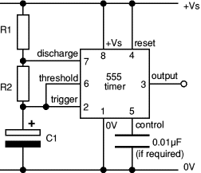
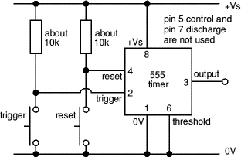
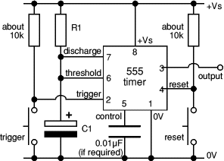
555 Timer
ASTABLE
MONOSTABLE
BISTABLE
Square wave generator
ON and OFF circuit
Turn ON for a while before switching off

Slide 5

555 Timer
ASTABLE
When the 555 is in ASTABLE mode is period (T) is given by
$$T=\ln\left(2\right)\left(R_{1} + 2R_{2}\right)C_{1}$$
Square wave generator

Slide 6
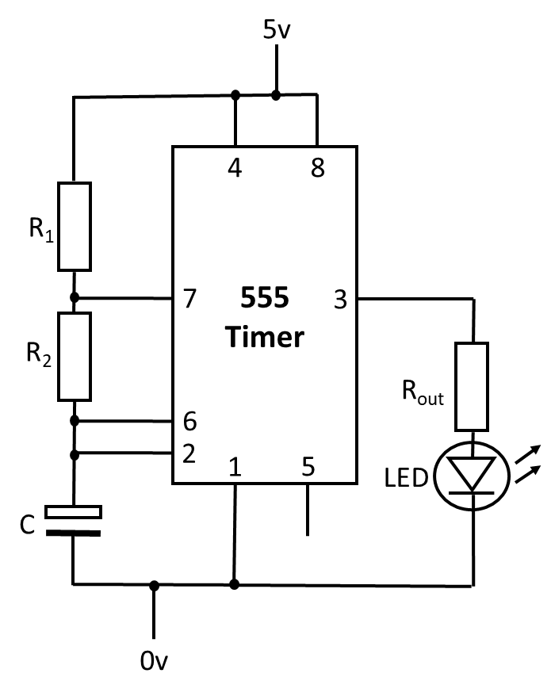
Lab activity 1
Connect the circuit as shown
You can use any value resistor for R₁ , R₂ , R_{out} and C

Slide 7
Binary adder

Slide 8
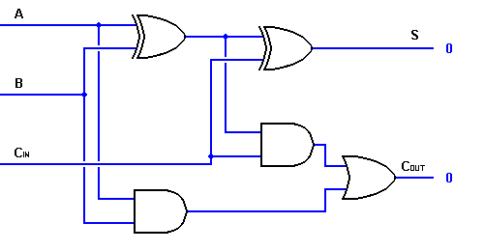
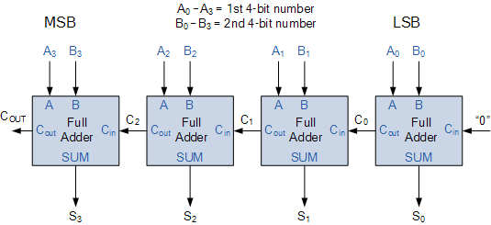
Binary adder
Binary full adder circuit
A Binary full adder is used to added 2 binary number together. A and B
Multiple Binary full adder can be cascaded together
Cascaded Binary full adder

Slide 9
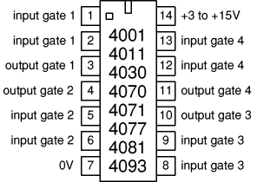
Pin layout for
4001 quad 2-input NOR
4011 quad 2-input NAND
4030 quad 2-input EX-OR (now obsolete)
4070 quad 2-input EX-OR
4071 quad 2-input OR
4077 quad 2-input EX-NOR
4081 quad 2-input AND
4093 quad 2-input NAND with Schmitt trigger inputs
For Full adder circuit, we will use 3 IC chip 1) 4081 (quad 2-input AND)
2) 4071 (quad 2-input OR)
3) 4070 (quad 2-input EX-OR)
Ensure that the IC chip Pin 14 is connect to positive supply of the power source and Pin 1 is connected to ground

Slide 10
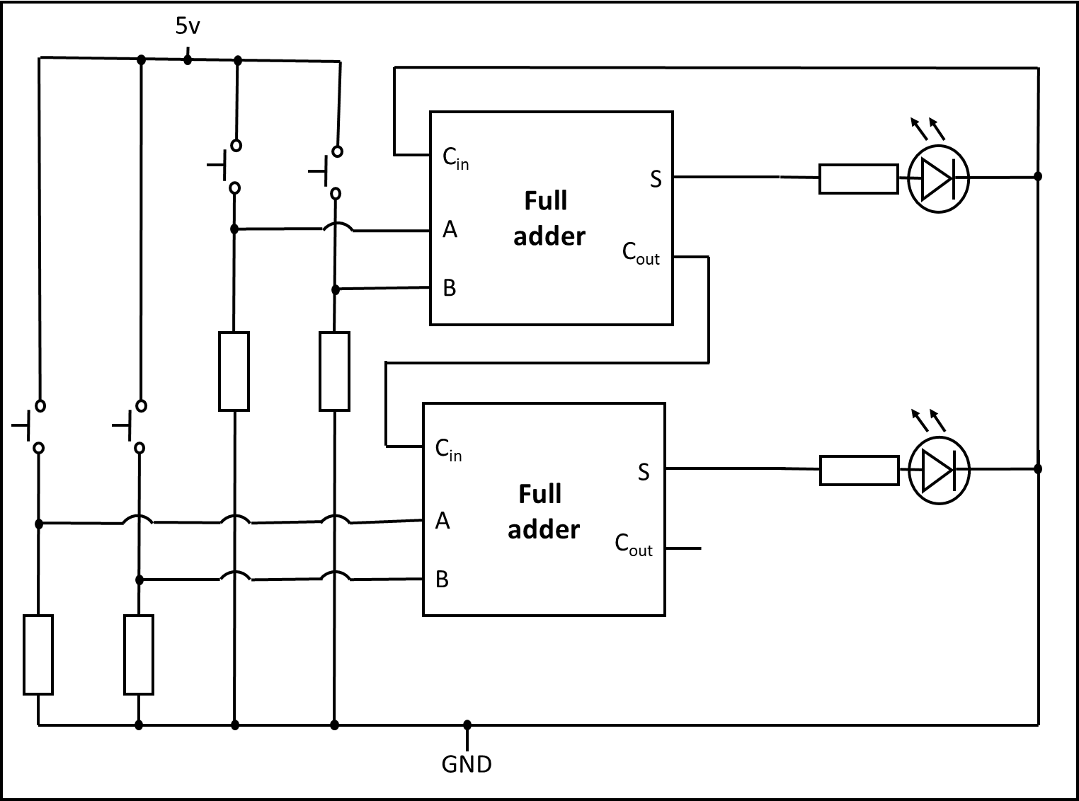
Lab activity 2
2 bit full adder circuit
Connect the circuit as shown
The Binary full adder circuit is in pervious slide. You need to construct the full adder first before you can construct the 2 bit full adder circuit

Slide 11
Sum over product, Product over SUM or K-map

Slide 12
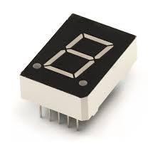
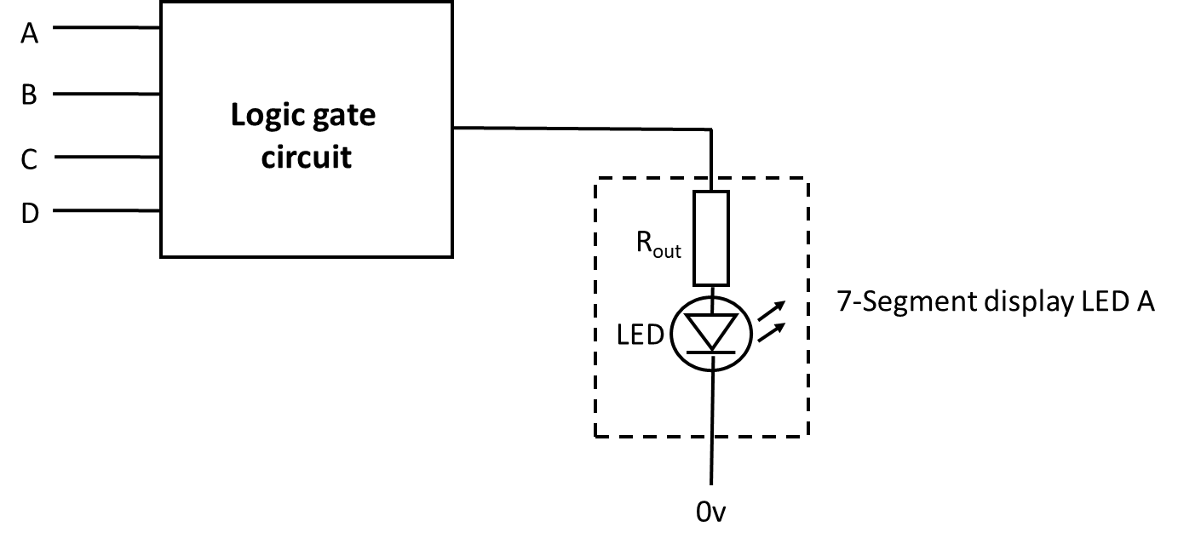
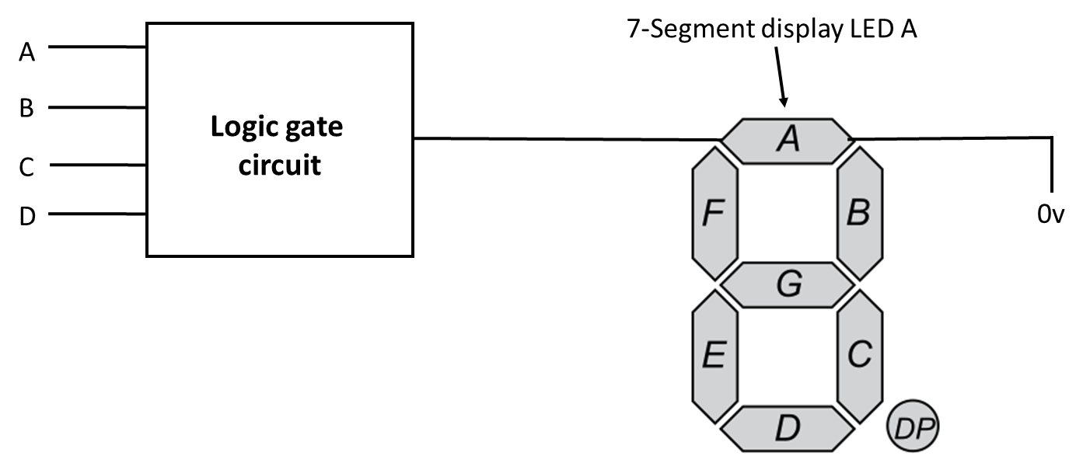
Sum over product, Product over SUM or K-map
DESIGN PROBLEM
Design a logic circuit with 4 inputs A, B, C and D with A being the MSB and D being the LSB that represent the 4 BCD inputs that will turn ON or OFF LED A of the common cathode 7-Segment display depending on the BCD input from decimal 0₁₀ to 9₁₀. From 1010₂ to 1111₂ which is invalid BCD input, LED A will be OFF.

Slide 13
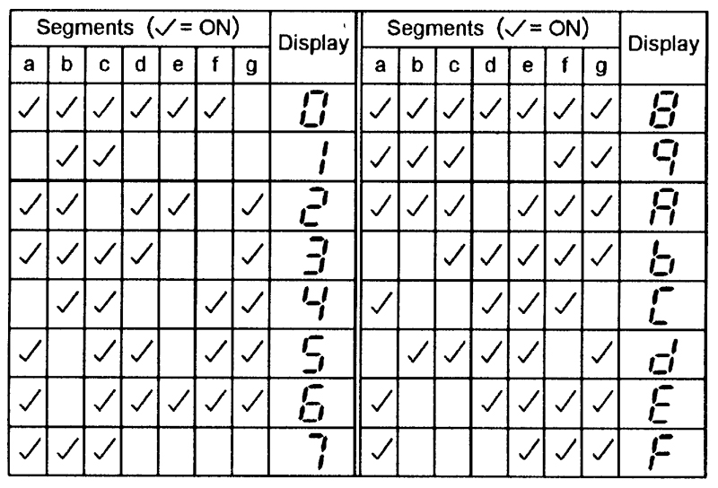
Truth table
Input |  |  |  | Output
A | B | C | D | 7-Segment display LED A
0 | 0 | 0 | 0 | 1
0 | 0 | 0 | 1 | 0
0 | 0 | 1 | 0 | 1
0 | 0 | 1 | 1 | 1
0 | 1 | 0 | 0 | 0
0 | 1 | 0 | 1 | 1
0 | 1 | 1 | 0 | 1
0 | 1 | 1 | 1 | 1
1 | 0 | 0 | 0 | 1
1 | 0 | 0 | 1 | 1
1 | 0 | 1 | 0 | 0
1 | 0 | 1 | 1 | 0
1 | 1 | 0 | 0 | 0
1 | 1 | 0 | 1 | 0
1 | 1 | 1 | 0 | 0
1 | 1 | 1 | 1 | 0
From the 7-Segment Display table, we will fill out the truth table for LED A as such.
7-Segment Display table

Slide 14
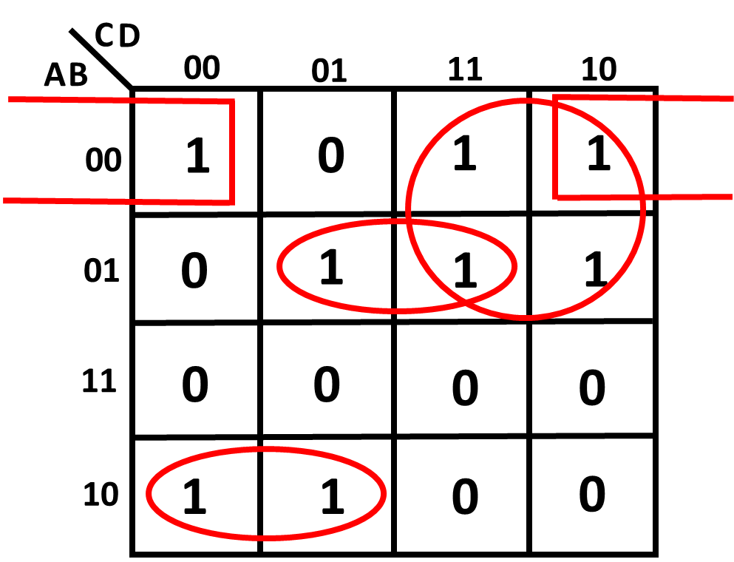
You can use SOP, POS or K-map to solve, in this example, we will use a K-map
Truth table
Input |  |  |  | Output
A | B | C | D | 7-Segment display LED A
0 | 0 | 0 | 0 | 1
0 | 0 | 0 | 1 | 0
0 | 0 | 1 | 0 | 1
0 | 0 | 1 | 1 | 1
0 | 1 | 0 | 0 | 0
0 | 1 | 0 | 1 | 1
0 | 1 | 1 | 0 | 1
0 | 1 | 1 | 1 | 1
1 | 0 | 0 | 0 | 1
1 | 0 | 0 | 1 | 1
1 | 0 | 1 | 0 | 0
1 | 0 | 1 | 1 | 0
1 | 1 | 0 | 0 | 0
1 | 1 | 0 | 1 | 0
1 | 1 | 1 | 0 | 0
1 | 1 | 1 | 1 | 0
$$Y= \overline{A}\left(C+\overline{B}\overline{D}+BD\right)+A\overline{B}\overline{C}$$

Slide 15
Lab activity 3
Implement and connect the circuit below
$$Y= \overline{A}\left(C+\overline{B}\overline{D}+BD\right)+A\overline{B}\overline{C}$$

Slide 16
The END

